Slide 1



The past, present and future of the tree of life
(theory of evolution)
By
Nada Mohamady Farouk Abdalsalam
ID: 2021B8017715001
From Egypt
M. Sc. Student at Shenzhen Institute of advanced technology

Slide 2

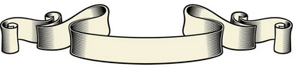

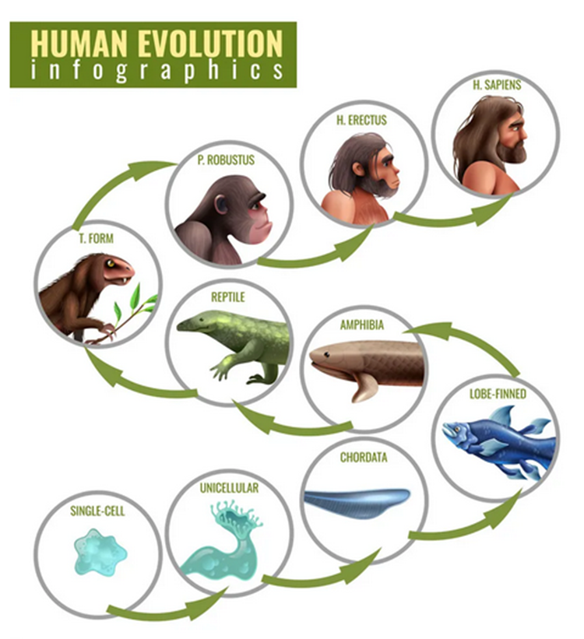
Aim of the PPT
Evolution
Voyage of the Beagle
Evolutionary theory
supporting evidences of theory evolution
Eyewitnesses to Evolution
Conclusion
References

Slide 3

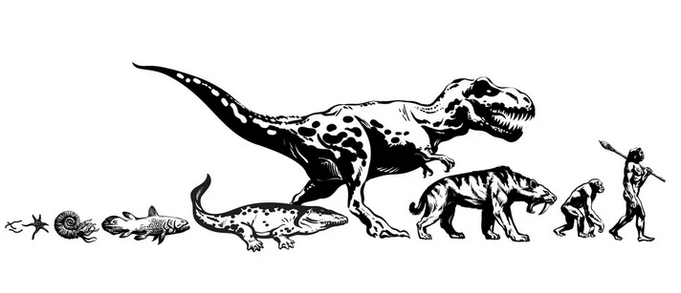
Evolution
In biology, evolution is the change in the characteristics of a species over several generations and relies on the process of natural selection. The theory of evolution is based on the idea that all species are related and gradually change over time (1).

Slide 4
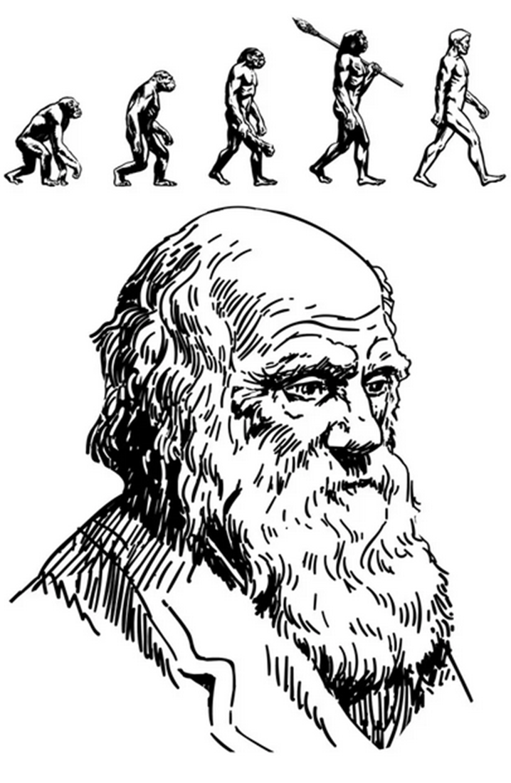

How do you think
Darwin came up with
his theory?

Slide 5
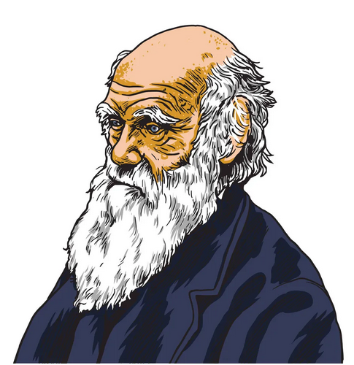

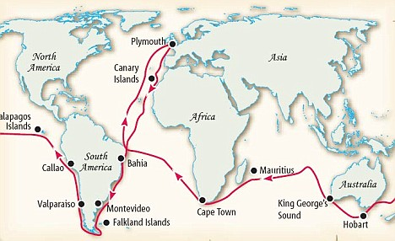
Voyage of the Beagle:
In 1831, Charles Darwin received an astounding invitation: to join the HMS Beagle as ship's naturalist for a trip around the world. For most of the next five years, the Beagle surveyed the coast of South America, leaving Darwin free to explore the continent and islands, including the Galápagos (2).

Slide 6

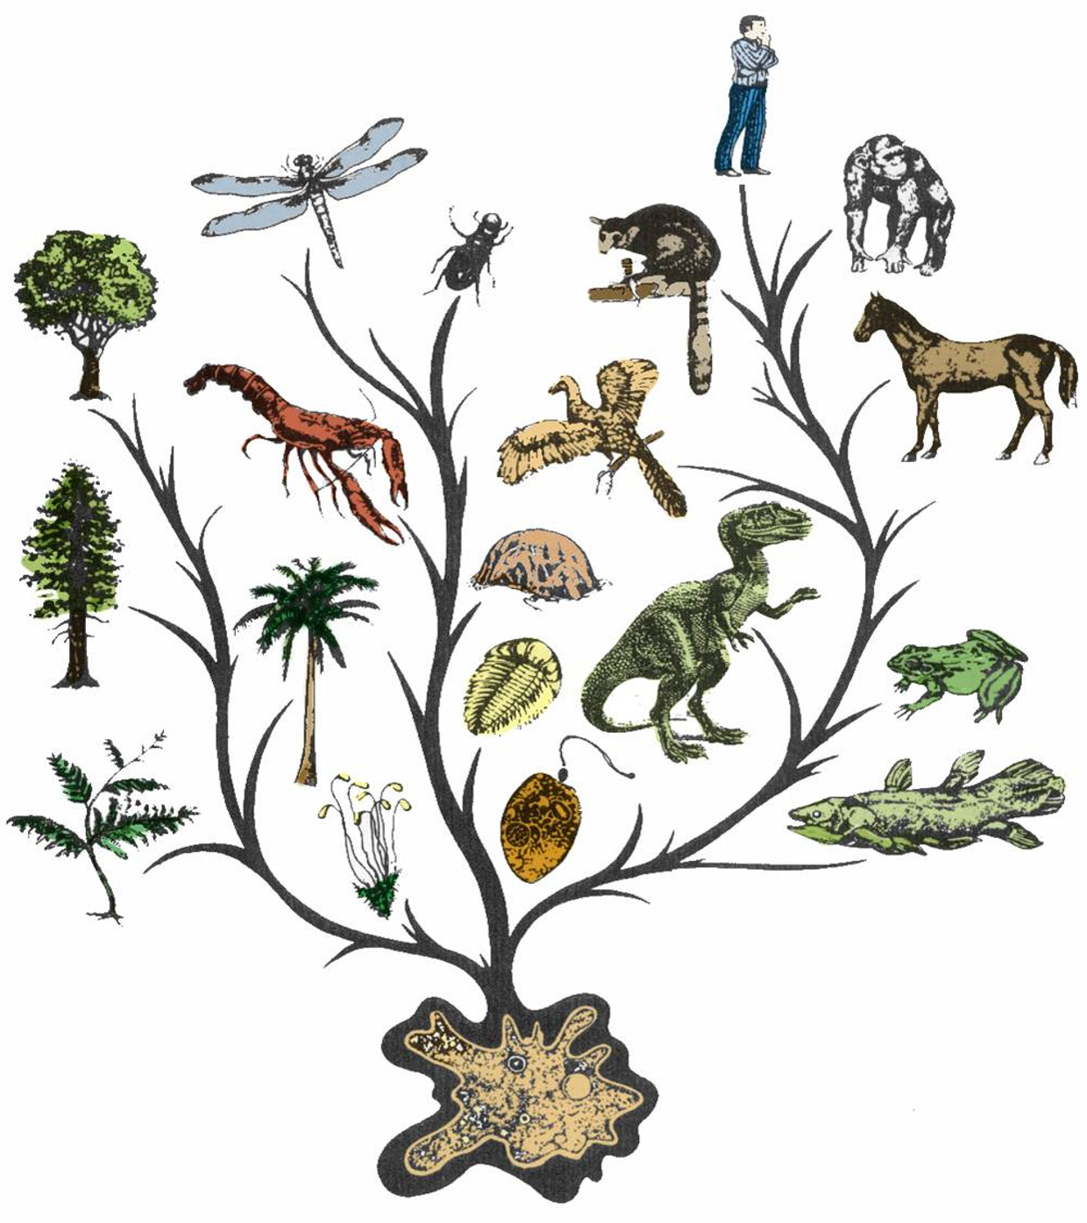

Evolutionary theory:
The theory of evolution is based on the idea that all species are related and gradually change over time. Evolution relies on there being genetic variation in a population which affects the physical characteristics (phenotype) of an organism (3).

Slide 7
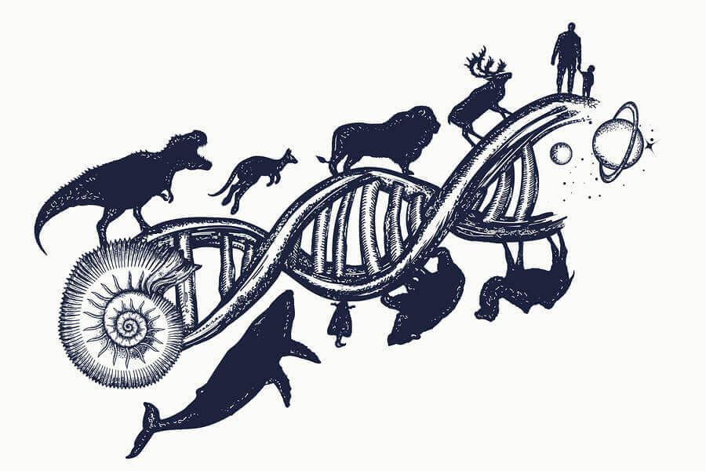
Supporting evidences of theory evolution:

Slide 8

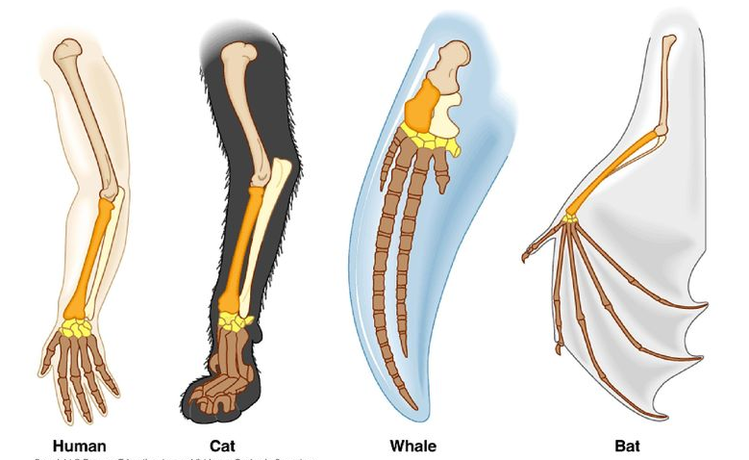

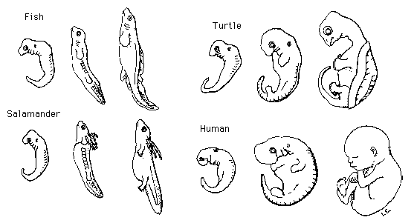
Comparative anatomy:
studding cerine organisms show similarities in the anatomical features (4).
Comparative embryology:
aims to understand how embryos develop, and to research the inter-relatedness of animals. It has bolstered evolutionary theory by demonstrating that all vertebrates develop similarly and have a putative common ancestor (5).

Slide 9
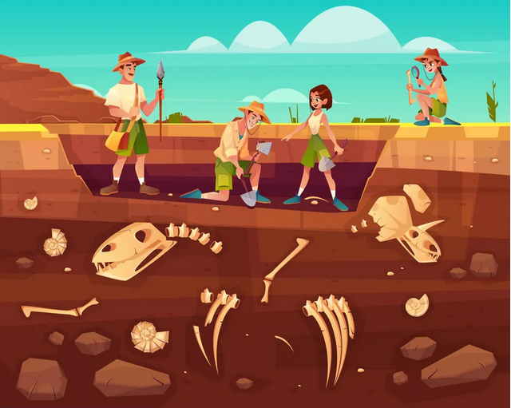
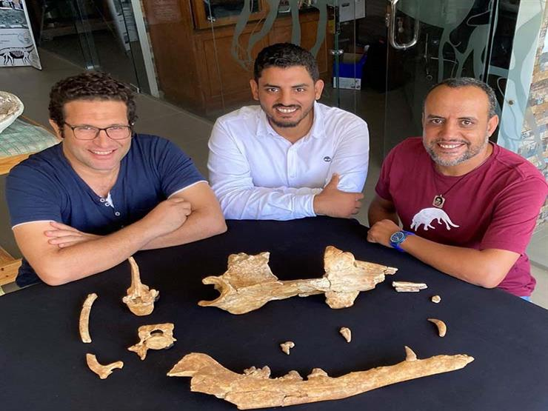
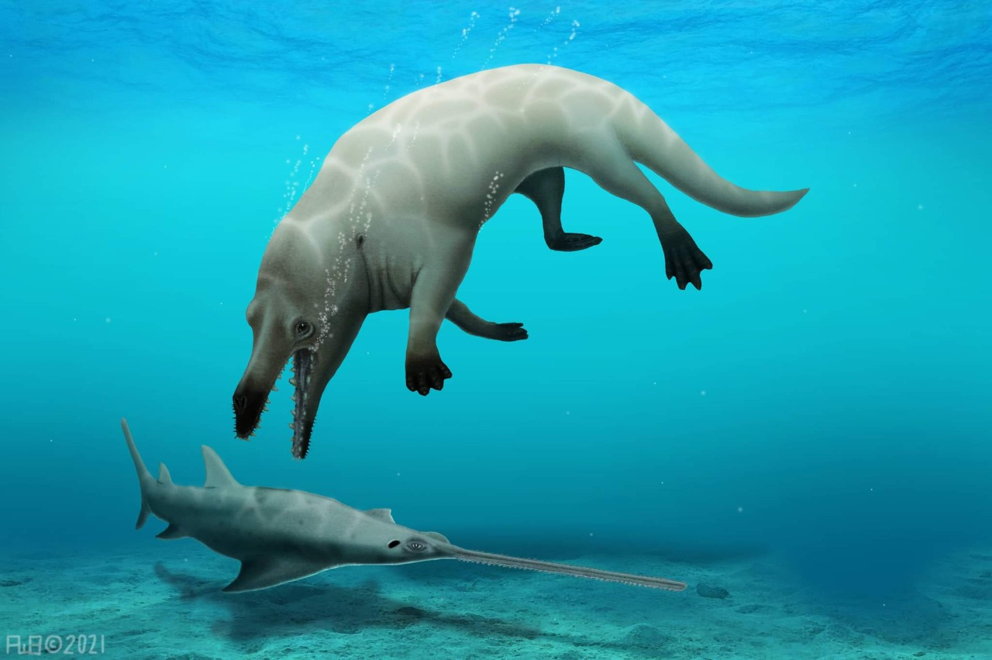
Fossils:
Fossils document the existence of now-extinct past species that are related to present-day species (6).
Abdallah
Dr. Mohamed
Phiomicetu
By Egyptian team
PhD student: Abdallah Gohar
Prof. Dr. Hisham Salam
Prof. Dr. Mohamed Sameh (7)
Dr. Hisham

Slide 10
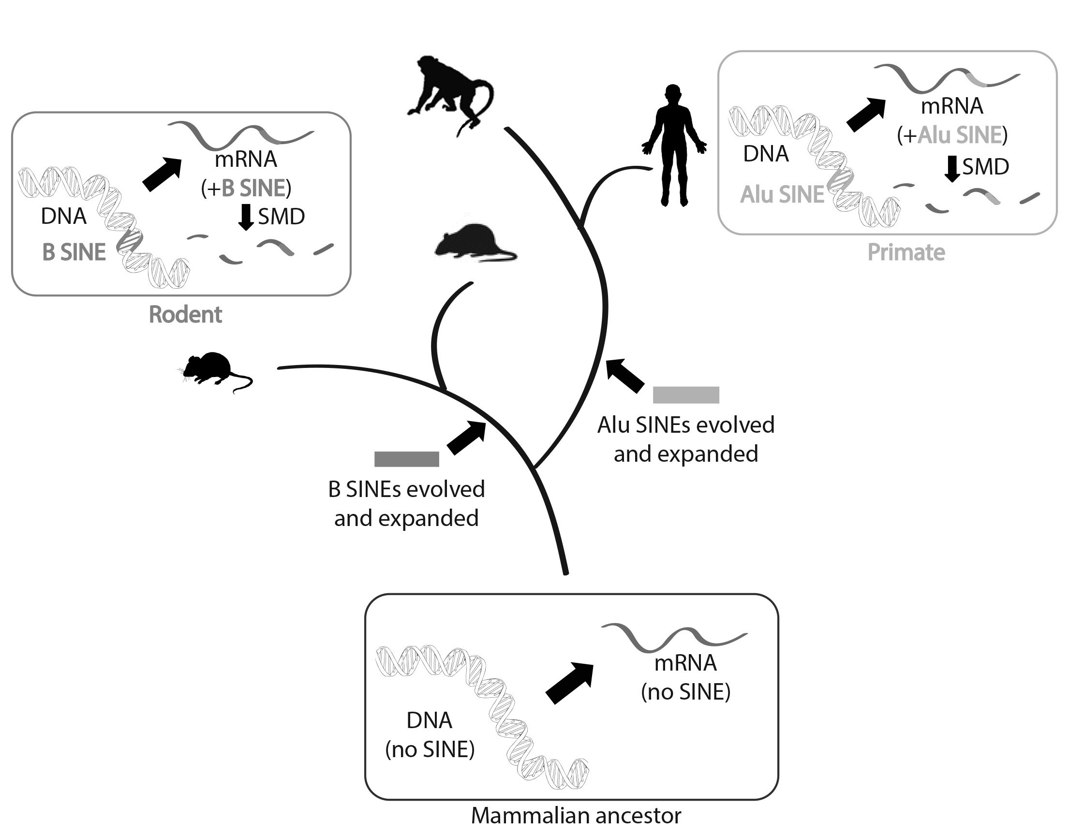
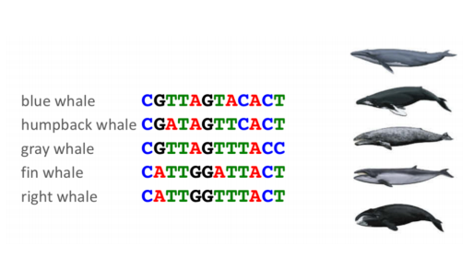
Comparing DNA ( Molecular biology):
Darwin could compare only the anatomy and embryos of living things. Today, scientists can compare their DNA. Similar DNA sequences are the strongest evidence for evolution from a common ancestor.
The cladogram in the figure shows how humans and apes are related based on their DNA sequences (8).

Slide 11
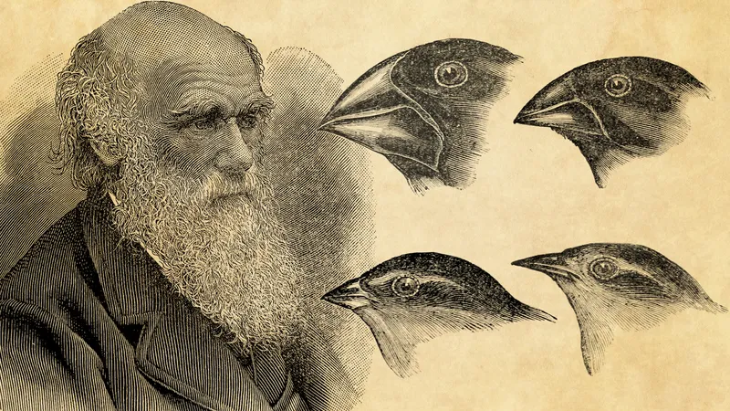
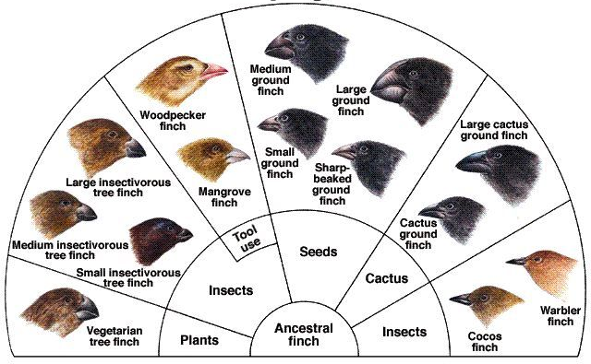
It evolved into many finch species, each adapted for a different type of food.
Galápagos finches differ in beak size and shape, depending on the type of food they eat. Those eating buds and fruits have the largest beaks. Insect and grub eaters have narrower beaks(6).
Island Biogeography:
The biogeography of islands yields some of the best evidence for evolution
for example: the birds called finches that Darwin studied on the Galápagos Islands.
All of the finches probably descended from one bird that arrived on the islands from South America (6).

Slide 12

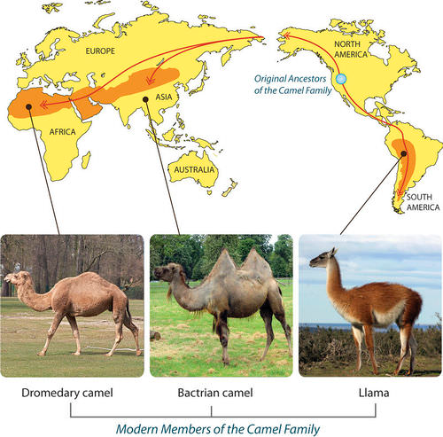
Evidence from Biogeography
Biogeography is the study of how and why organisms live where they do. It provides more evidence for evolution
Let’s consider the camel family as an example.
Members of the camel family now live in different parts of the world. Dromedary camels are found in Africa, Bactrian camels in Asia, and Llamas in South America.
They differ from one another in a number of traits. However, they share basic similarities. This is because they all evolved from a common ancestor (6-8).

Slide 13

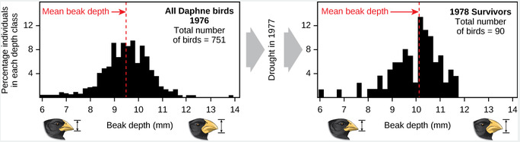
Eyewitnesses to Evolution
In the 1970s, biologists Peter and Rosemary Grant went to the Galápagos Islands to re-study Darwin’s finches. They spent more than 30 years on the project, but their efforts paid off. They were able to observe evolution by natural selection actually taking place.
While the Grants were on the Galápagos, a drought occurred, so fewer seeds were available for finches to eat. Birds with smaller beaks could crack open and eat only the smaller seeds. Birds with bigger beaks could crack open and eat seeds of all sizes. As a result, many of the smaller-beaked birds died in the drought, whereas birds with bigger beaks survived and reproduced.
within 2 years, the average beak size in the finch population increased. In other words, evolution by natural selection had occurred (9).

Slide 14

Evolution is the process of a species' features changing over numerous generations through natural selection.
Evolutionary theory
supporting evidences of theory evolution
Comparative anatomy
Comparative embryology
Fossils
Comparing DNA ( Molecular biology)
Island Biogeography
Evidence from Biogeography
Eyewitnesses to Evolution

Slide 15
References
Coccia, M., & Watts, J. (2020). A theory of the evolution of technology: Technological parasitism and the implications for innovation magement. Journal of Engineering and Technology Management, 55, 101552.‏
Schollenberger, J. (2019). To describe an alien planet: An experience of landscape in" The Voyage of the Beagle" by Charles Darwin. Polish Journal of Landscape Studies, 2(4-5), 23-33.‏
Pumain, D. (2018). An evolutionary theory of urban systems. In International and transnational perspectives on urban systems (pp. 3-18). Springer, Singapore.‏
Smith, R., Steklis, H. D., Steklis, N. G., Weihs, K. L., & Lane, R. D. (2020). The evolution and development of the uniquely human capacity for emotional awareness: A synthesis of comparative anatomical, cognitive, neurocomputational, and evolutionary psychological perspectives. Biological Psychology, 154, 107925.‏
Kuo, D. H. (2019). Comparative Embryology as a Way to Understand Evolution. In Old Questions and Young Approaches to Animal Evolution (pp. 57-72). Springer, Cham.‏
https://www.google.com/url?sa=t&rct=j&q=&esrc=s&source=web&cd=&cad=rja&uact=8&ved=2ahUKEwjA6OeI5Y33AhUYQEEAHaueA74QFnoECAYQAQ&url=https%3A%2F%2Fwww.ncbi.nlm.nih.gov%2Fbooks%2FNBK230201%2F&usg=AOvVaw3IBOVMSaNzu29oNtIGj4B6
Gohar, A. S., Antar, M. S., Boessenecker, R. W., Sabry, D. A., El-Sayed, S., Seiffert, E. R., ... & Sallam, H. M. (2021). A new protocetid whale offers clues to biogeography and feeding ecology in early cetacean evolution. Proceedings of the Royal Society B, 288(1957), 20211368.‏
Arkhipova, I. R. (2018). Neutral theory, transposable elements, and eukaryotic genome evolution. Molecular biology and evolution, 35(6), 1332-1337.‏
Simberloff, D. S. (1974). Equilibrium theory of island biogeography and ecology. Annual review of Ecology and Systematics, 5(1), 161-182.‏

Slide 16

Any Question
No, hard question, please

Slide 17



